Slide 1


DITAP Refresh
December Survey Report
December 20, 2024

Slide 2
Agenda
Research plan
Methodology
Key findings
Details of key findings
Future enhancements
Next steps

Slide 3
Research plan

Slide 4
Background
Digital IT Acquisition Program (DITAP) transforms federal procurement practices
Created in 2014
Base curriculum hasn’t stayed current
Project aims to reimagine the curriculum
We want a curriculum that
provides more experiential learning
open-source
agile
responsive to change
both current and future-proof

Slide 5
Research information
SurveyMonkey survey
Web-based
Single-use link
12 questions
Satisfaction
Rating
Open-ended responses

Slide 6
Research goals
Our hope was this survey would help validate
What needs to be refreshed
What needs to be updated
What works best for program participants
What was out-of-date
If the curriculum contained too much or too little information
If it included enough experiential learning and different modality activities
How alumni feel about the current curriculum
How to structure the project roadmap

Slide 7
Methodology

Slide 8
Research hypothesis
We hypothesized the research would validate the following assumptions:
The curriculum content contains outdated information
The current curriculum could benefit from the addition of different learning modality activities
Former DITAP participants agree that the course is beneficial in their role
Alumni will request more examples of the application of the DITAP skills
We can gauge if there's interest in a DITAP alumni program

Slide 9
Research methods
SurveyMonkey survey
Accessible on any device or operating system
Single-use link
Sent via email
Survey was anonymous
Included an option for follow-up interviews

Slide 10
Key findings

Slide 11
Survey stats
Survey contained 12 questions
Average time to complete was 6 minutes
Completion rate (answering every question even if it was optional) 79%
Survey was open from November 26 - December 06, 2024
Sent to 775 participants
82 responses (~11%)
22 respondents (~27%) elected to participate in a follow-up interview

Slide 12
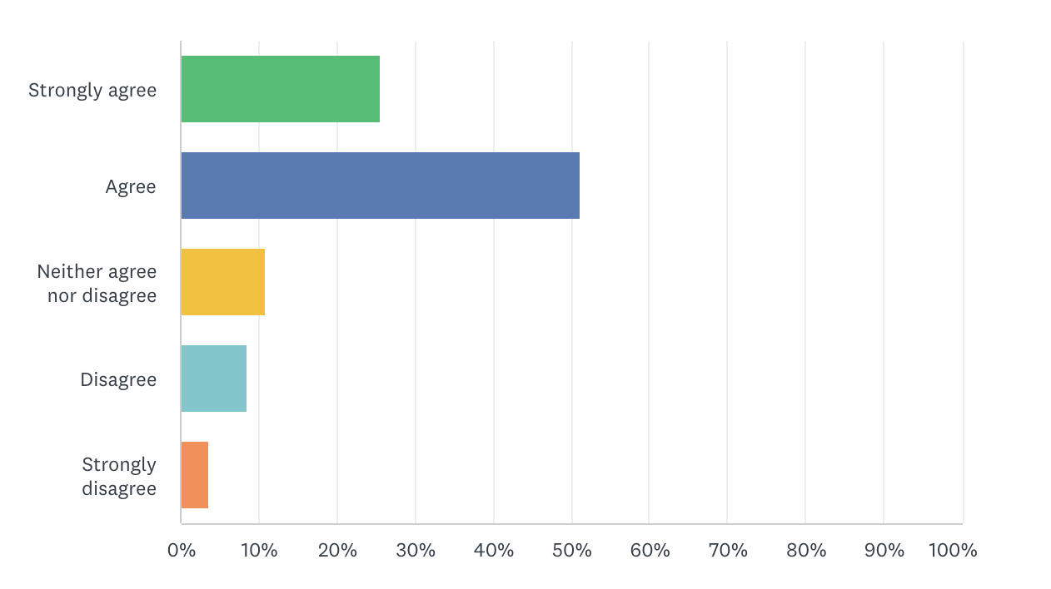
Question stats
I feel the DITAP curriculum content is current for today’s procurement process.
63 out of 82 respondents (~76%) strongly agree or agree with this statement
10 out of 82 respondents (~12%) disagree or strongly disagree with this statement

Slide 13
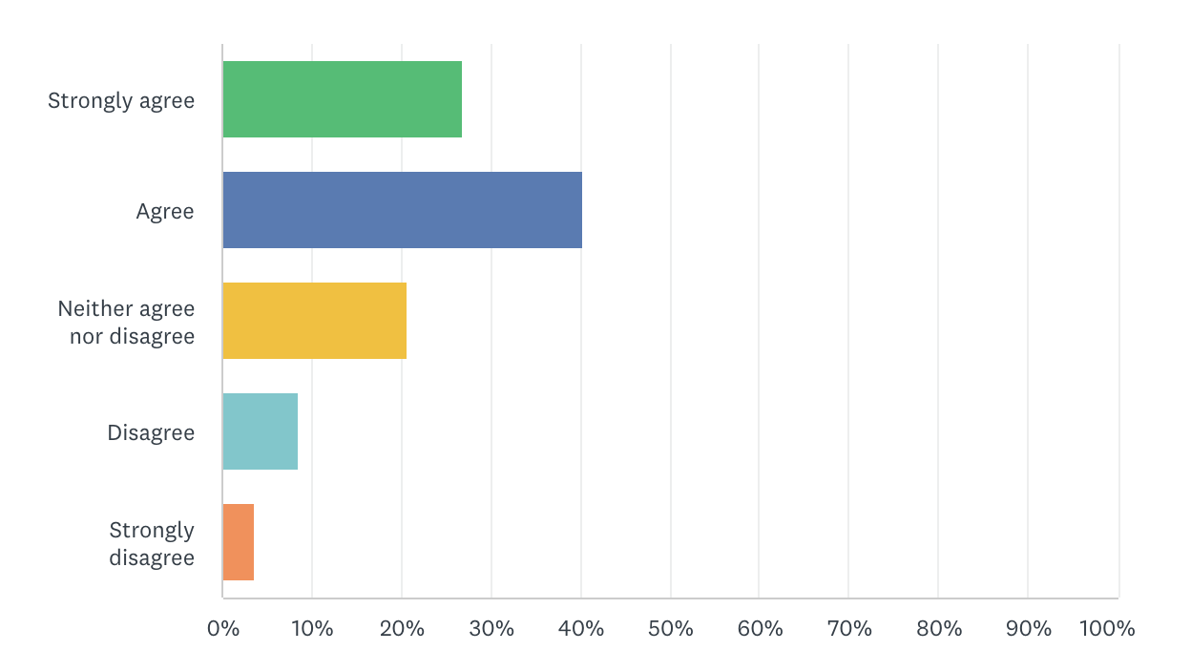
Question stats
2. I can explain how I’ve applied the curriculum content to the current digital acquisition process.
55 out of 82 respondents (~67%) strongly agree or agree with this statement
10 out of 82 respondents (~12%) disagree or strongly disagree with this statement

Slide 14
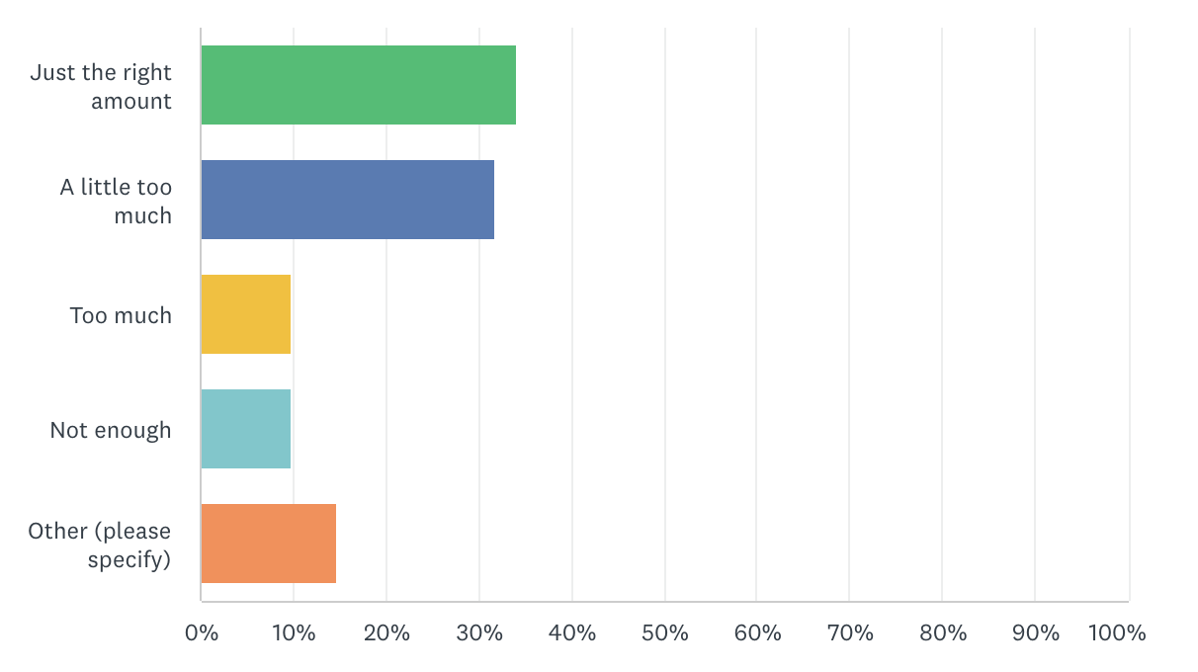
Question stats
3. In my opinion, the amount of information presented in each release was
28 out of 82 respondents (~34%) thought it was just the right amount
34 out of 82 respondents (~41%) thought it was a little too much or too much

Slide 15
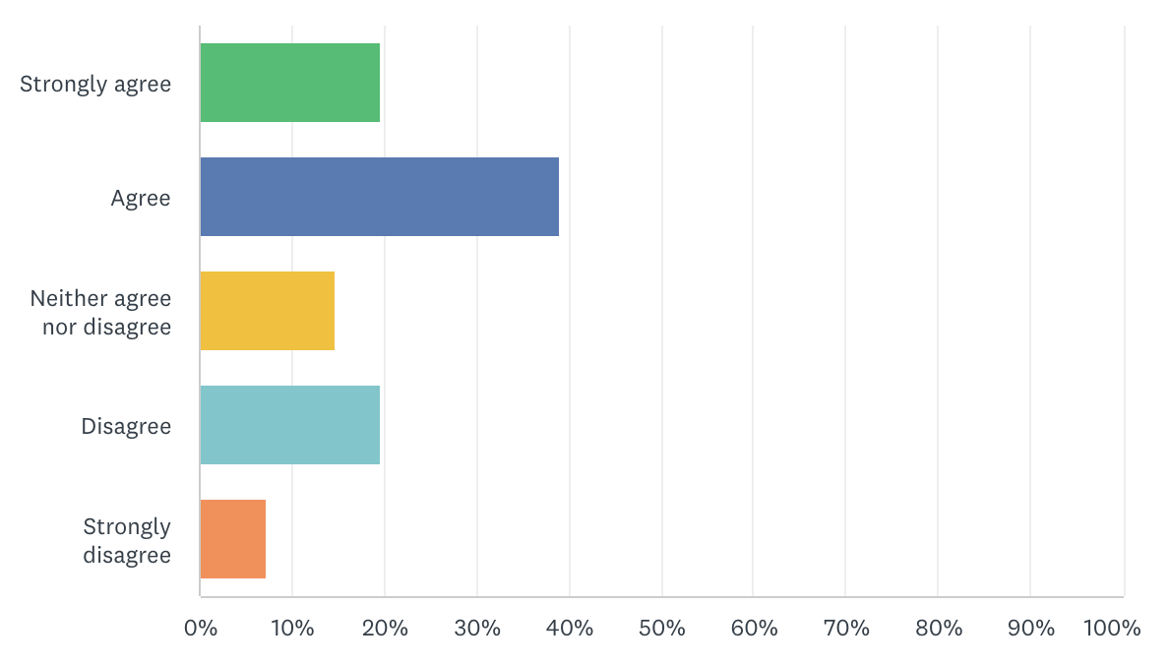
Question stats
4. The length of the course was appropriate for the amount of information provided.
48 out of 82 respondents (~58%) strongly agree or agree with this statement
22 out of 82 respondents (~26%) disagree or strongly disagree with this statement

Slide 16
Question stats
5. We asked respondents to evaluate how successfully the DITAP curriculum prepared them for the following skills: - Leading digital procurement initiatives - Applying agile methodologies to acquisitions - Collaborating with technical teams - Managing modern software development contracts - Evaluating digital service proposals
62 out of 82 respondents (~76%) found the DITAP curriculum best prepared them to collaborate with technical teams. 58 out of 82 respondents (~70%) found the DITAP curriculum prepared them to apply agile methodologies to acquisitions
10 out of 82 respondents (~12%) found the DITAP curriculum least prepared them to lead digital procurement initiatives

Slide 17
Question stats
*6. We asked respondents to evaluate how effective the following learning methods were: - Live virtual sessions - Shadowing assignment - Self-paced modules - Case studies - Stakeholder assignment - Hands-on exercises - Capstone group project - Peer discussions
67 out of 75 respondents (~89%) found the Live virtual sessions the most effective 62 out of 75 respondents (~82%) found the Hands-on exercises effective
15 out of 75 respondents (~20%) found the Capstone group project the least effective
*This question was not a required question to answer

Slide 18
7. Which elements of the course did you find useful to you as a working professional?
Of 61 respondents who answered this question:
20 found the shadowing assignment the most useful
14 found the course resources and case studies the most useful
11 found the stakeholder assignment the most useful
“The shadowing assignment was useful because it provided the opportunity to see the concepts in real time.”

Slide 19
7. Which elements of the course did you find useful to you as a working professional?
Of 61 respondents who answered this question:
7 found learning about agile methodology the most useful
6 found the live virtual sessions the most useful
5 found real-life hands-on activities and collaboration the most useful.
4 found having a shared acquisition vocabulary the most useful
“The hands-on training tasks were beneficial to actual implications of how to structure and format requirements”

Slide 20
8. What could be the biggest improvement to the current DITAP course curriculum?
Of 63 respondents who answered this question:
10 found the lack of real-world application the area we could improve the most
9 found the course structure the area we could improve the most
7 found the lack of course and activity expectations, and lack of course feedback the area we could improve the most
“Need more emphasis on practical, hands-on application of the concepts learned”

Slide 21
8. What could be the biggest improvement to the current DITAP course curriculum?
Of 63 respondents who answered this question:
6 found the course curriculum the area we could improve the most
5 found the course length the area we could improve the most, with 4 suggesting it could be shorter
Other callouts included the amount of readings and homework, provided lectures, and peer discussions as areas we could improve
“We felt like we were teaching ourselves instead of being taught”

Slide 22
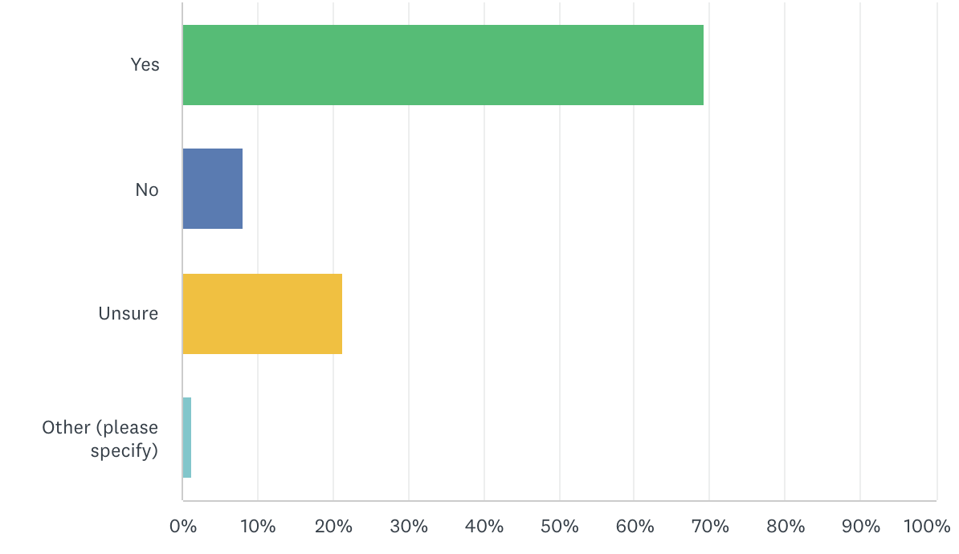
9. Would you benefit from a DITAP alumni network where you could continue to engage with your peers, instructors, and course content?
52 out of 75 respondents (~69%) would benefit
6 out of 75 respondents (~8%) wouldn’t benefit
16 out of 75 respondents (~21%) are unsure

Slide 23
10. Would you be interested in participating in a DITAP alumni network?
47 out of 75 respondents (~63%) are interested
11 out of 75 respondents (~15%) aren’t interested
17 out of 75 respondents (~23%) might be interested

Slide 24
11. Are there additional comments or suggestions you’d like to share with us?
12. Are you willing to participate in a brief 20-minute interview with a member of our team? Please enter your name and email address if you are.

Slide 25
Details of key findings

Slide 26
Mural synthesis
Link to mural
We used Mural to capture and affinitize the SurveyMonkey survey results. Using Mural allows us to identify themes, group similar feedback, and provide a visual display of the survey feedback.
In the mural, you’ll find:
affinitized positive and negative feedback
most useful course elements
user quotes
course feedback
possible future enhancements or features
In the following slides we’ll discuss the information found in the mural

Slide 27
Start
Spend more time covering material in the virtual classroom vs self-guided learning
Provide a glossary of terms and acronyms
Provide more regular and frequent feedback
Redesign the LMS portal to make it easy to find assignments, readings, and resources
Provide more real-life, hands-on learning opportunities
Increase in-class collaboration and interactions
Provide a release wrap-up one-page “What you’ve learned” review document
Provide clearer expectations on assignments and group activities
Connect the dots between information and applicability in the procurement process

Slide 28
Stop
Assigning work with unclear or vague instructions
Focusing the Capstone assignment on building our own digital service, rather than procuring one
Using acronyms regularly without defining what they mean
Having no accountability for group participation
Sending out assignments and readings with broken or inaccessible links
Relying primarily on independent assignments and reading to cover the material

Slide 29
Continue
Shadowing assignment
Course resources
Stakeholder assignment
Case studies
Live virtual classes
Agile lessons
Classroom and group collaboration
Hands-on training
Real world examples
In-class discussions of the material

Slide 30
Future enhancements

Slide 31
Possible enhancements or features
Build or incorporate a hover state or tooltip functionality that defines acronyms on interaction
Build a branching DITAP course, where each release has an assessment. If you pass the assessment, you receive feedback and can move to the next activity. If you don’t pass, you receive feedback and are taken to review materials.
Consider having each release being its own course to lessen the course time commitment in addition to daily work requirements and deadlines.
Build a DITAP counterpart for our customers or bring customers in to help bridge the gap between their work and the world of 1102s
Create a downloadable set of course resources or a one-page/workbook that helps refresh and review course content

Slide 32
What’s next?

Slide 33
Next steps
Schedule follow-up interviews with interested alumni
Compare alumni survey data with audit findings
Review vendor survey results
Build out a refresh roadmap based on surveys and audit findings
Assess future enhancements for viability and value add
Get started!
Continue doing user research and testing along the way

